Slide 1
Architecting for ML
On AWS
Amazon SageMaker
Emily Webber
January 9, 2018
Notes:
Yes you can ask a question if you have one. I will be stopping periodically to make sure you’re getting what you want and need.

Slide 2
Architecting for Machine Learning Agenda
Day 1
ML on AWS
NLP Lab
Teams
New Problem
Day 2
Feature Engineering
Project
Evaluation
Day 3
Going Into Production
Build
Present!
Write Up
New Model
Architecture

Slide 3
Feature Engineering
Deep Dive

Slide 4
Eighty percent of the data science work is feature engineering

Slide 5
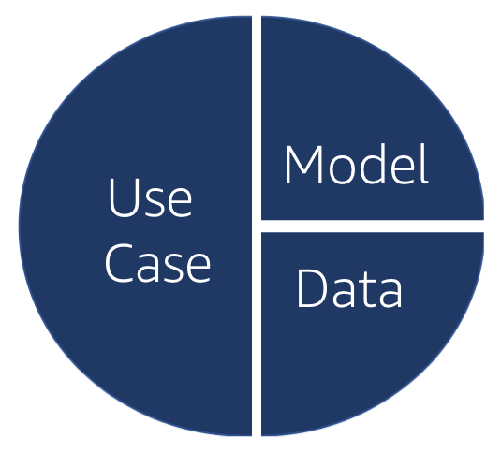
Feature Engineering
Conceptual, i.e. research-level
Practical, i.e. developer-level

Slide 6
Feature Engineering - Conceptual
What rows and columns are in my data set already?
Do those actually represent the real world?
How are they going to interact with my model?
Do I need to transform any columns? Normalize? Standardize?
Do I need to remove any outliers?
Do I need to combine any columns?
Do I need to add additional features?

Slide 7
Feature Engineering - Practical
How do I change the type of data I’m working with?
What Python and Pandas functions will I use?
Are my X’s and Y’s actually lining up? If not, why?
Do I have the mechanics properly set up?
Do I have everything I need to launch my training job?

Slide 8
Python & Pandas: DataFrame
import pandas as pd
df = pd.read_csv(“file_name.csv”)
headers = list(df)
df[“my columns”].hist()
for idx, row in df.iterrows():
d = row[“my column”]
df.iloc[idx, “other column”] = new_value

Slide 9
Let’s get started!

Slide 10
Model Comparison
Deep Dive

Slide 11


Confusion Matrix
Your Model’s Predictions
Positive
Negative
Recall
True
Positive
False
Negative
Your Labeled Data
Positive
Negative
False
Positive
True
Negative
Precision

Slide 12
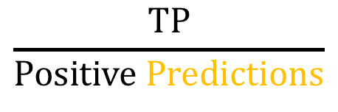
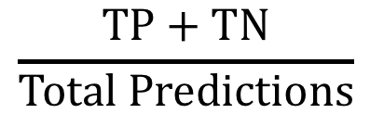
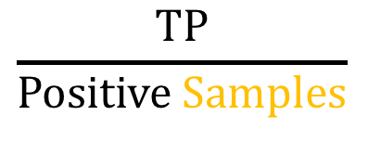
Common Model Evaluation Metrics
$$\frac{TP+TN}{Total Predictions}$$
$$\frac{TP}{Positive Predictions}$$
$$\frac{TP}{Positive Samples}$$
Accuracy
Precision
Recall
AUC of ROC

Slide 13
Receiver Operator Curve
True Positive Rate
False Positive Rate

Slide 14
It is very helpful to align model evaluation directly with business goals.

Slide 15
Loss Function – Give different impact to different errors when training the model
Training
Economic Weights– Quantify the economic impact of the model outputs to evaluate results
Analysis

Slide 16
https://aws.amazon.com/blogs/machine-learning/training-models-with-unequal-economic-error-costs-using-amazon-sagemaker/

Slide 17
Use the evaluation questions to ask interesting questions about about your project. Over time, as you become a machine learning practitioner, you should be able to answer them. Today, don’t stress yourself out.

